Slide 1
Caerus – Sampling of related techniques and open problems
Theodoros Gkountouvas, Hui Lei, Hongliang Tang, Yong Wang, Lin Zhang

Slide 2
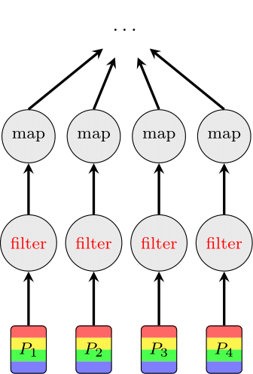
Semantic Cache - Motivation
Query/Task example
Load whole dataset.
Filter in only all red data which is a small portion of the initial data.
Continue with the ensuing operations until your task/query is fully executed.
Problem
Load whole data but operate only on a small portion of it.
Leads to excessive:
Storage I/O
Network I/O
CPU resources utilized
Memory space utilized
Can we leverage data/metadata from the execution of previous queries/tasks to minimize these overheads?
Notes:
Can we benefit from execution of previous queries in order to load less data?

Slide 3
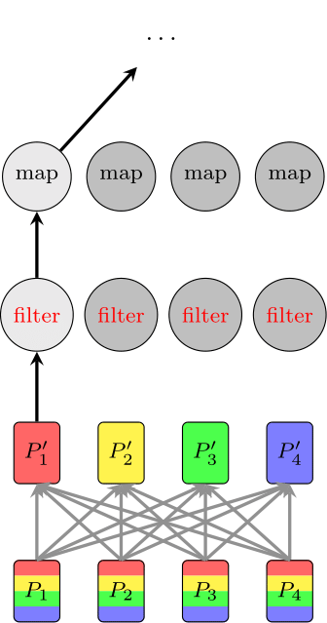
Semantic Cache - Adaptive Partitioning
Change partitioning scheme of the underlying data.
Adaptive: Dynamically adopts new partition schemes according to the executed workload needs.
Requires costly operation which effectively requires a full shuffle operation.
Make sure the benefits outweigh the costs:
Reduce the re-partitioning cost.
Execute multiple queries/tasks that benefit for this approach.
Eliminate multiple partitions from loading (partition pruning) per query/task.

Slide 4
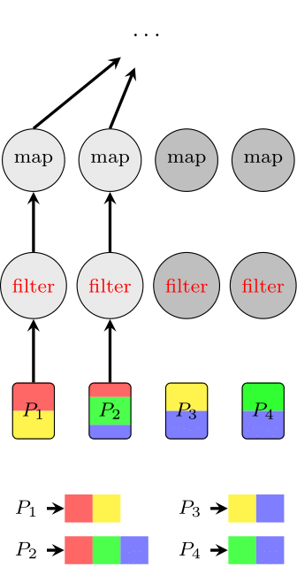
Semantic Cache - Data Skipping
Maintain metadata for secondary attributes (not main partition attributes) per partition.
Skipping: Metadata is used to skip partitions during the execution of specific query/task, that can safely eliminate all the elements of skipped partitions and still obtain the same result.
Incurs less computation and storage overhead than Adaptive Partitioning.
Less effective in data elimination than Adaptive Partitioning.

Slide 5
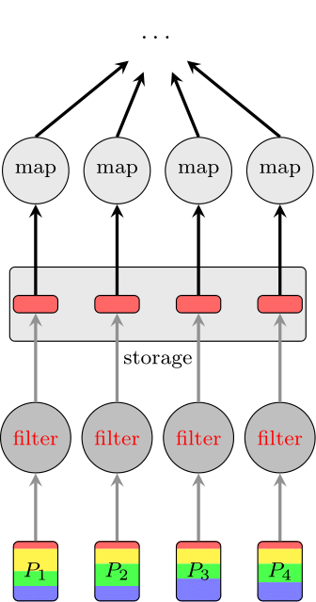
Semantic Cache - Caching Intermediate Data
Cache intermediate results after processing the initial data (either to memory or storage).
Any time an ensuing query/task runs, if there is no loss of information by loading the intermediate results, then only the cached data would be loaded (some operations might also be eliminated).
Causes storage overhead commensurate to intermediate data size.
Might cause computation overhead, since intermediate result needs to be materialized.
Reduces storage I/O and computation overhead.
Notes:
Filter operation might be merged with map operations and executed simultaneously. In this case the result of the filter operation is never materialized in the optimal execution of this workload.

Slide 6


Semantic Cache - Architecture
Compute
Cluster 1
Compute
Cluster 2
Compute
Cluster N
Initial Data Storage
Replicates data to different storage nodes for fault-tolerance.
Holds a collection of files/objects/tables.
Intermediate Data and Metadata Storage
Holds metadata and intermediate data, that results from processing of initial data.
Can reproduce content from initial data. Content is not required for correctness, only for performance improvement.
Shared Multi-Layered Cache
Caches content from both initial data and intermediate data and metadata storage.
Utilizes different layers like conventional cache hierarchies in order to improve efficiency and enable sharing between different clusters.
Compute Clusters
Perform data analysis using distributed processing engines (e.g. Spark).
…
Shared Multi-Layered Cache
Analytics
Data Lake
Initial Data
Intermediate Data
& Metadata

Slide 7

Semantic Cache - Architecture
What are the optimal configurations and policies?
Components
Multi-Layered Memory Cache
Intermediate Data/Metadata
Evaluation Metrics
Average query/task execution time
Total CPU time (compute resources)
Total storage I/O overhead (storage resources)
Principles
End-to-end approach is better than isolated/independent approach.
Use application-level semantics to improve performance.
Make automatic decisions without adding extra parameters and requiring modifications in the source code by users.
Cost-effective solutions
Secure and fair solutions
Compute
Cluster 1
Compute
Cluster 2
Compute
Cluster N
…
Shared Multi-Layered Cache
Analytics
Data Lake
Initial Data
Intermediate Data
& Metadata

Slide 8
NDP - Motivation
Analytics Cluster
Computations on top of whole amount of initial unprocessed data. Examples include:
selection, projection operations (simple operations)
aggregation, sample, top-k operations (Big Data)
classification, dataset shuffle, k-means (AI)
custom operations (UDFs)
Network I/O analogous to the amount of initial unprocessed data.
Memory resources required on Analysis Cluster side analogous to the amount of initial unprocessed data.
Data Lake processing capabilities are not utilized.
load data
Analytics
Data Lake
Data Lake Cluster

Slide 9
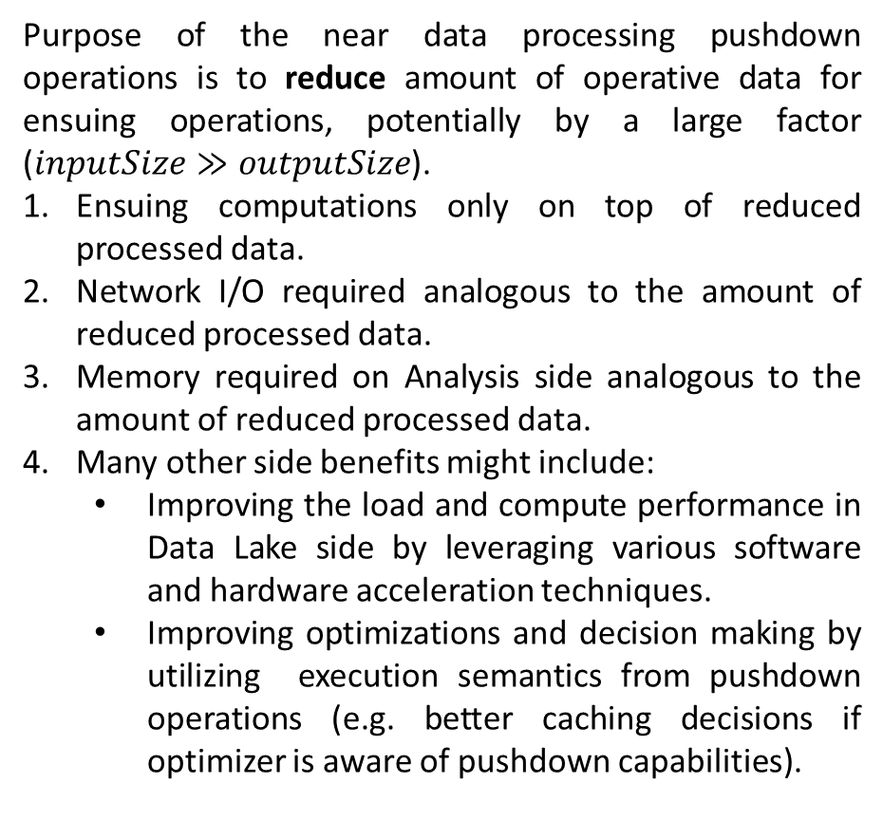
NDP - Motivation
Analytics Cluster
Purpose of the near data processing pushdown operations is to reduce amount of operative data for ensuing operations, potentially by a large factor ($inputSize≫outputSize$).
Ensuing computations only on top of reduced processed data.
Network I/O required analogous to the amount of reduced processed data.
Memory required on Analysis side analogous to the amount of reduced processed data.
Many other side benefits might include:
Improving the load and compute performance in Data Lake side by leveraging various software and hardware acceleration techniques.
Improving optimizations and decision making by utilizing execution semantics from pushdown operations (e.g. better caching decisions if optimizer is aware of pushdown capabilities).
load data;
pushdown-op0;
pushdown-op1;
…
Analytics
Data Lake
Data Lake Cluster

Slide 10


NDP-Architecture
NDP Client
Object storage service using OS/POSIX interfaces. Use HTTP(s) based REST API, that can support custom request body to embed pushdown information. Three popular examples of similar approaches are:
AWS S3 (SelectObjectContent or S3 Select)
SNIA CDMI (Cloud Data Management Interface)
OpenStack Swift (Storlet)
If the request doesn’t have the pushdown request body in the HTTP(s) request, the request should be forwarded directly to storage service (out-of-band approach).
The NDP service decides if the pushdown operations should be executed by the S3 Select module (SQL operations) or the more generic one (custom computations). Caerus S3 Select Service and Secure Custom Computations modules can be implemented as one module. However, due to increasing popularity of SQL query on storage, we plan to support it separately (performance, security).
(1)
NDP Service
S3 Select
Secure Custom Computation
(2)
(3)
H/W Acceleration Service
CPU SIMD
GPU RAPIDS
(4)
Storage
(5)
Programmable SSDs

Slide 11
NDP-Architecture
NDP Client
The Caerus Hardware Acceleration Service will apply acceleration when input or output data objects are processed. The two major techniques in the consideration are:
CPU SIMD Technology
Open GPU RAPIDS Data Science Technology
In normal cases, there are storage media layer like HDDs and SDDs. Caerus plans to extend pushdown further into storage media, more specifically, into programmable SSDs (in I/O context) or SCM (in memory context). Caerus aims to significantly reduce storage system resource consumption and improve performance in some cases by getting advantage of programmable SSDs.
Return path is omitted for simplicity.
(1)
NDP Service
S3 Select
Secure Custom Computation
(2)
(3)
H/W Acceleration Service
CPU SIMD
GPU RAPIDS
(4)
Storage
(5)
Programmable SSDs
Notes:
https://cacm.acm.org/magazines/2019/6/237002-programmable-solid-state-storage-in-future-cloud-datacenters/fulltext

Slide 12
Holistic Approach - Architecture
Spark SQL/ML/Core
TensorFlow
Presto
Analytics Support
Analytics
Engines
Optimization Logic
Spark Driver
TF Driver
Presto Driver
Storage Augment
Master
Node
Query/Task
Analyzer
Query/Task
Executor
Query/Task
Executor
Worker
Node
…
Worker
Node
Near Data Processing Client
Near Data Processing Client
Semantic Cache
Compute
Storage
NDP Service
Data Lake
Storage

Slide 13
Holistic Approach - Design
Driver
Query/Task Analyzer
Semantic Cache
Query/Task Executor
NDP Client
NDP Service
Determine Query/Task Candidates
Initialize
Initialize
Send Logical DAG
Parse Logical DAG
Send Parsed Logical DAG
Optimize DAG (cached results, partition pruning)
Transform DAG (cache results, index, repartitions)
Send Optimized Logical DAG
Notes:
Transformations/optimizations are explained later.

Slide 14
Holistic Approach - Design
Driver
Query/Task Analyzer
Semantic Cache
Query/Task Executor
NDP Client
NDP Service
Transform Optimized Logical DAG for NDP
Transform Logical to Physical DAG
Send Physical DAG
Parse Physical DAG
Send NDP DAG
Transform NDP DAG to HTTP Request(s)

Slide 15
Holistic Approach - Design
Driver
Query/Task Analyzer
Semantic Cache
Query/Task Executor
NDP Client
NDP Service
Send HTTP request
Execute Request
Send HTTP response
Parse and Transform response
Send (status, [result])
Execute rest of Physical DAG
Accumulate results
Send (status, [result])
Send (status, [result])

Slide 16
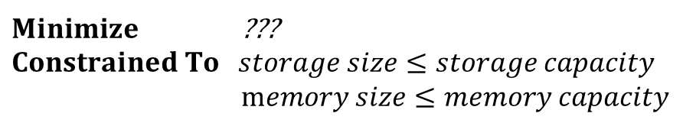
Open Problems
Interface?
Holistic Approach
Optimizations are applicable to multiple compute engines. What is a good representation for communication between compute engines and our platform? (Peregrine, SOCC ’19)
Support Big Data and ML workloads.
How do we optimize execution of multiple workloads (Sparkcruise,
VLDB ’19)?
Multiple Techniques into Consideration
Adaptive Partitioning
Data Skipping Metadata
Caching Intermediate Data
Prefetching/Precomputing
Scheduling
NDP execution
Explore sophisticate evaluation goals.
Performance (query/task execution time)
Resource usage (storage I/O, network I/O, CPU usage, etc.)
Cost-effectiveness (cost in $$)
Driver
Query/Task Analyzer
$Minimize$ ???
$$Constrained To storage size≤storage capacity$$
$memory size≤memory capacity$

Slide 17
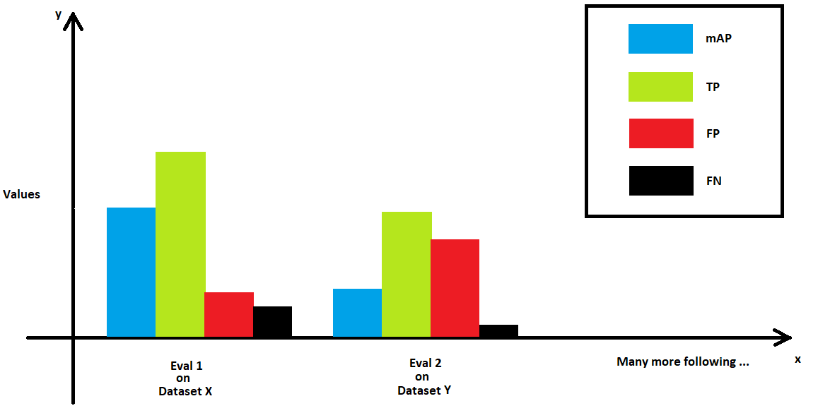

Open Problems
Holistic Approach
Evaluation is critical. We need traces of query/task executions (not just different types of queries/tasks like TPC benchmarks). How do we create one?
Randomly generate a sequence of query tasks with different parameters from existing benchmarks.
Rely on frequencies for different type of queries to generate sequences. Parameterization is still random.
We work in multi-tenant environments. What is fair use of these shared resources?
Provide meaningful fairness guarantees (e.g. perform at least as well as running in isolation with the fair amount of cache and NDP resources) for the multi-cluster environment.
Accommodate priority scheduling. Some jobs might be more critical compared to others.
Security guarantees are important in the multi-tenant environment. How Caerus can provide important security properties during the execution of multiple workloads in the presence of adversaries, like confidentiality, integrity and availability?
Compute
Cluster 1
Compute
Cluster 2
Shared Pool of Resources

Slide 18


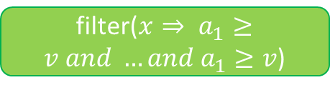
Open Problems
Semantic Cache
Better information leads to better decisions. How can we improve this information?
Intermediate size estimation
Runtime estimation
Resource usage estimation
What is an appropriate data format for initial data and intermediate data/metadata?
Try to support as many formats as possible for initial data.
Investigate what is the most performant format for Semantic Cache.
Explore data ingestion issues.
Can all the utilized techniques be further improved?
Better cost for repartitioning?
Better candidate selection (indexing, caching, repartitioning)?
More sophisticated indexing (workload-aware indexing)?
More sophisticated intermediate data caching (workload-aware)?
filter($x⇒ a_{1}≥v and …and a_{1}≥v$)
Size
spark.load(
“storage://orig1inal.data”)
Intermediate Data
& Metadata
Initial Data
Format

Slide 19
Open Problems
Near Data Processing
Can we automatically determine NDP operations to pushdown based on storage characteristics/capabilities on compute side?
What type of operations provide benefits when pushed to storage side?
Filter
Project
Aggregation
Sample
Top-K
…
How can we benefit from H/W acceleration?
More operations can be supported (only pushdown predicates are supported now).
Range predicates
Substring predicates
Query/Task
Analyzer
NDP
NDP Service
Support
H/W Acceleration Service
CPU SIMD
GPU RAPIDS
Notes:
Security,
Caching Extra,

Slide 20
Thank You

Slide 22
Competitive Analysis – Semantic Caching
Company | Product | Storage System | Distributed Caching | Multi-Modal Caching | Predictive Caching | Workload-Aware Caching | Multi-Tier Caching
Alluxio | Alluxio | Multiple | Centralized | Manual | Manual | Manual | Memory, SSD, HDD
Databricks | Spark Cache | Multiple | Decentralized | Source Data, Intermediate Data | No | Spark DAG | No
IBM | Big Data Skipping | COS | Centralized | Indices | Yes | No | Storage
Microsoft | Microsoft Azure – Databricks | Multiple | Centralized | Source Data, Intermediate Data (including re-partitions) | No | Yes | Memory, Storage

Slide 23
Research Innovations – Semantic Caching
University | Project Name | Conference | Storage System | Distributed Caching | Multi-Modal Caching | Predictive Caching | Workload-Aware Caching | Multi-Tier Caching
Texas, Microsoft Research India | INSTalytics | FAST 2019 | Filesystem (HDFS) | Centralized | Source Data, Re-partitioned Data | No | Selection Operation | Only Storage
MIT CSAIL, Microsoft | Amoeba | SoCC 2017 | Filesystem (HDFS) | Centralized | Source Data, Re-partitioned Data | No | Selection Operation | Only Storage
UC Berkeley | Partitioning for Aggressive Data Skipping | SIGMOD 2014 | Filesystem (HDFS) | Centralized | Indices | No | Selection Operation | Only Storage
Hong Kong | LRC, LERC | INFOCOM 2017 | Multiple | Centralized | Intermediate Data | No | Spark DAG | Memory/Storage
Boston, Northeastern | Caching in the Multiverse | HotStorage 2019 | Ceph | Centralized | Intermediate Data | Yes | Pig, Hadoop DAG | Memory/Storage

Slide 24
Competitive Analysis - NDP
Company | Product | Analytics Engine | Storage System | What to Pushdown | How to Pushdown | Where to Pushdown to | How to Execute | Notes
MinIO | S3 Select | Spark (Spark-Select) | Object Storage: MinIO | Simple projections, predicates, and aggregation | SQL | Storage processors (SPs) | SPs ingest, parse and filter CSV and Json files with limited hw/sw acceleration | Better performance than AWS S3 Not support complex operations No I/O optimization due to lack of indexing No UDFs
Amazon AWS | S3 Select and Glacier Select | Up to users | Object Storage: AWS S3 | Simple projections, predicates, and aggregation | SQL | Information unavailable, probably similar to MinIO | Information unavailable, probably similar to MinIO | Become object storage standard Great APIs and SDKs Not support complex operations No UDFs
RedHat (IBM) | Ceph Object Classes (CLS) | UDFs and Postgres | Unified Storage (block/file/object) based on Object Storage: Ceph | UDFs and most SQL operations | UDFs and SQL | SPs to object store (OSD) | LUA VM on storage side can talk to OSDs via extension interfaces | Need extensive work to port CLS like implementation into other storage systems
IBM | OpenStack SWIFT Storlet | Spark etc. | Object Storage: SWIFT | UDFs and most of SQL operations | UDFs and SQL | Via SWIFT proxy to storage nodes | Storlet Dockers on storage side can support UDFs and SQL | Specific to SWIFT, hard to port to other systems No sw/hw accelerations
Oracle, IBM etc. | Exadata (Oracle) Netezza (IBM) | RDMS | Non-disaggregated appliances | Wide range of SQL operations | SQL | Information unavailable, all-in-one box or vendor-controlled storage servers | Information unavailable, all-in-one-box or vendor-controlled storage servers | Traditional RDMS appliances or vendor controlled storage server, hard to reuse in generic storage systems
MongoDB | MongoDB (NoSQL) | NoSQL | Proprietary storage | Wide range of query (Json) operations | NoSQL and SQL (wrapper) | Storage engines | Storage engine manages how data is stored both in memory and drives | Proprietary storage specific to this database, hard to reuse in generic storage systems

Slide 25
Related Research - NDP
University | Project Name | Conference | Analytics Engine | Storage System | What to Pushdown | How to Pushdown | Where to Pushdown to | How to Execute
University of California Santa Cruz | SkyhookDM | Ongoing research project, many conferences: Vault’19, ‘20, FAST19 etc. | Postgres | Ceph | UDFs and most SQL operations | UDFs and SQL via Postgres FDW (Foreign Data Wrappers) | SPs to object store (OSD) via CLS | LUA VM on storage side can talk to OSDs via extension interfaces CLS.
University of Wisconsin-Madison & MIT | PushdownDB | ICDE2020 | Homegrown PushdownDB on top of AWS S3 | AWS S3 (Select) | Extended SQL operations like join, group-by, and top-K | Used native S3 Select operations | AWS S3 object storage | Used multiple-steps commercial available AWS S3 Select to support more SQL operations
Reutlingen University & TU Darmstadt, Germany | NativeNDP | ADBIS 2019 | R Platform | Ceph | Data transformation | Used UDF via Ceph CLS to push R-native operations on to their storage abstraction DataFrame; similar to SkyhookDM | Pushdown to Ceph object store (OSDs); Then further push down to SCM storage devices; similar to SkyhookDM | Implemented Ceph CLS for R by using Ceph RADOS Object APIs on storage side, so it can run UDFS to transform data on storage side; similar to SkyhookDM
University of California, Irvine | Catalina (“Catalina: In-Storage Processing Acceleration for Scalable Big Data Analytics”) | Journal of Big Data, 2019 & Euro Conf on Parallel, Distributed and Network-based Processing 2019 | MPI (Message Passing Interface) & Hadoop | Edge Computational Storage Devices, SNIA term “CSD” | Special example: image similarity search using MPI | Embedded MPI slaves in storage devices, so that everything is a pushdown | ISP (In-Stroage-Processing) Engine: including ISP OS (user space + kernel), firmware, FPGA and storage | Using ARM and FPGA to process and accelerate; using programmable SSD (Flash interface) to pushdown operations
KTH Royal Institute of Technology, Sweden | Not applicable (“Identifying the potential of Near Data Processing for Apache Spark”) | International Symposium on Memory Systems 2017 | Spark | Server Storage | Not applicable, but they did great job to measure compute, memory and storage distribution in wide range of Spark workloads like Spark core, SQL, ML, Graph X, and Streaming, to see what are the best workloads for ISP pushdown, PIM (processing-in-memory, in relate to caching) pushdown or hybrid: ISP matches well with normal Spark SQL and Spark core etc. non-iterative batch; PIM suits streaming processing and iterative batch processing workload in Spark; Machine Learning workloads in Spark are best for hybrid of ISP and PIM. This can provide guideline for our holistic orchestration.

Slide 26
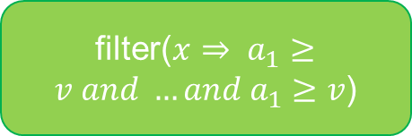

Example: Repartitioning
…
…
Spark.write(
“cache://repart.data”)
filter($x⇒ a_{1}≥v and …and a_{1}≥v$)
filter($x⇒ a_{1}≥v and …and a_{1}≥v$)
repartition(attribute)
spark.load(
“storage://original.data”)
spark.load(
“cache://repart.data”)
spark.load(
“storage://original.data”)
metadata
Notes:
Metadata refers to the original plan or the repartitioning plan

Slide 27
Example: Indexing
…
…
Spark.write(
“cache://index.data”)
filter($x⇒ a_{1}≥v and …and a_{1}≥v$)
filter($x⇒ a_{1}≥v and …and a_{1}≥v$)
makeIndices(attribute)
spark.load(
“storage://original.data”)
spark.loadWithIndices(
“cache://index.data”)
spark.load(
“storage://original.data”)
metadata

Slide 28
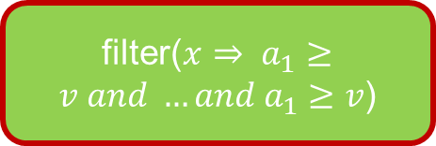

Example: Caching
…
…
Spark.write(
“cache://filter.data”)
filter($x⇒ a_{1}≥v and …and a_{1}≥v$)
spark.load(
“cache://filter.data”)
filter($x⇒ a_{1}≥v and …and a_{1}≥v$)
metadata
spark.load(
“storage://original.data”)
spark.load(
“storage://original.data”)

Slide 29
Example: NDP
…
…
filter($x⇒ a_{1}≥v and …and a_{1}≥v$)
spark.load(
“ndp://filter.data”)
filter($x⇒ a_{1}≥v and …and a_{1}≥v$)
metadata
spark.load(
“storage://original.data”)
spark.load(
“storage://original.data”)

